Slide 1

Global Population Trends: Insights using Python
Welcome to this presentation exploring global population trends using Python. We will delve into how Python can be used to analyze, visualize, and predict global population trends, uncovering insights into demographic shifts and their impact on the world.
TV
by Tej Varun

Slide 2
Objectives and Components
Objectives
Components
Collect and analyze global population data
Data Collection
Identify and predict population growth trends
Data Cleaning and Preprocessing
Visualize population changes with graphs and charts
Exploratory Data Analysis (EDA)
Assess the implications of population growth
Prediction Modeling
Data Visualization

Slide 3

Data Collection and Preprocessing
1
1. Data Sources
2
2. Data Formats
3
3. Data Cleaning
We obtain global population data from trusted sources like the World Bank, United Nations, and national census bureaus.
Data is downloaded in formats like CSV or JSON and loaded into Python for analysis using APIs.
We handle missing data, remove outliers, and convert data types to ensure accuracy and consistency.

Slide 4
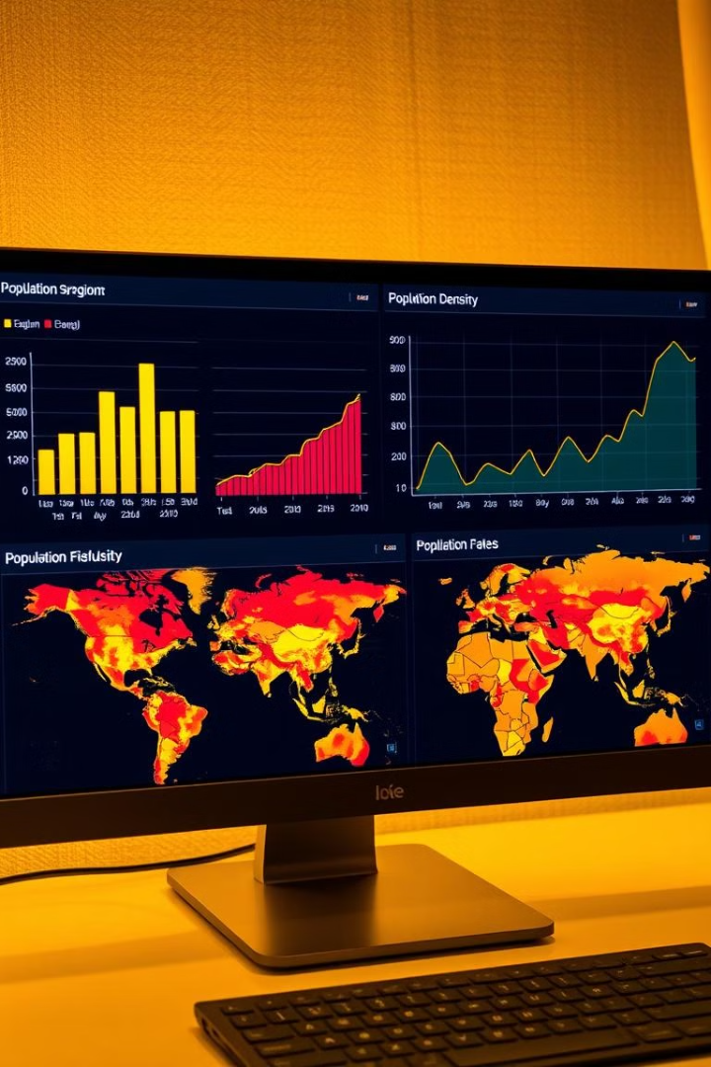



Exploratory Data Analysis (EDA)
Bar Charts
Visualize population distribution by region or country, highlighting variations and patterns.
Line Charts
Analyze population growth over time, identifying periods of rapid or slow growth.
Heatmaps
Represent population density across geographic regions, highlighting areas of high and low density.

Slide 5



Predictive Modeling
1. Linear Regression
1
Predict population growth using a linear relationship between past population data and time.
2. Time Series Forecasting
2
Apply techniques like ARIMA to predict population growth based on past trends and seasonal patterns.
3. Model Evaluation
3
Evaluate model accuracy using metrics like Mean Absolute Error (MAE) and Root Mean Squared Error (RMSE).

Slide 6

Challenges and Solutions
Data Quality
Data Processing
Incomplete or outdated data can pose a challenge. Solutions include data imputation and using multiple sources to fill gaps.
Large datasets require efficient processing techniques. Techniques like data aggregation and parallel processing can help manage large datasets.
Model Accuracy
Developing an accurate predictive model is challenging due to the complexity of factors affecting population growth. Solutions include using more complex models and incorporating relevant variables.

Slide 7

Impact and Applications
1
Informed Decision-Making
Provides valuable insights for policymakers, NGOs, and governments for resource allocation, urban planning, and sustainability efforts.
2
Educational Value
Serves as a valuable tool for teaching data analysis, forecasting, and Python programming in various fields.
3
Policy Implications
Insights can inform policies related to education, healthcare, infrastructure development, and climate change adaptation.
4
Predictive Capabilities
The model can be used to predict future population sizes, assisting in planning for population-related challenges.

Slide 8

Conclusion and Next Steps
This project demonstrates how Python can be used to analyze and predict global population trends, providing valuable insights into demographic shifts and their impact. While challenges remain, the project highlights the importance of data-driven decision-making in understanding and addressing population dynamics. Future research can focus on refining the model, incorporating new data sources, and exploring more advanced machine learning techniques for more accurate predictions.

